Slide 1

CRG-023, A Novel Tri-specific CAR T Product Candidate Engineered To Prevent Antigen Escape And Sustain Durable Anti-tumor Functionality Against B-cell Malignancies
I. Sagiv-Barfi, E. Liao, M. Mannon, B. Quach, L. Wang, S. Koo-McCoy, M. Yi, J. Byers, N. Nguyen, T. Bentley, S. Yung, Y. Huang, M. Bethune, M. Siegel and M. Ports
Acknowledgement of S. Zompì
ASH abstract

Slide 2
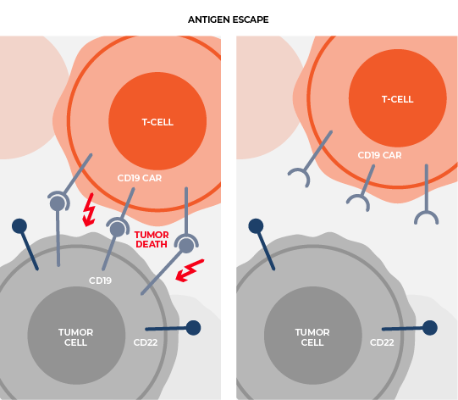
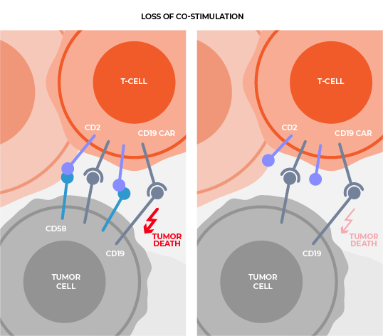
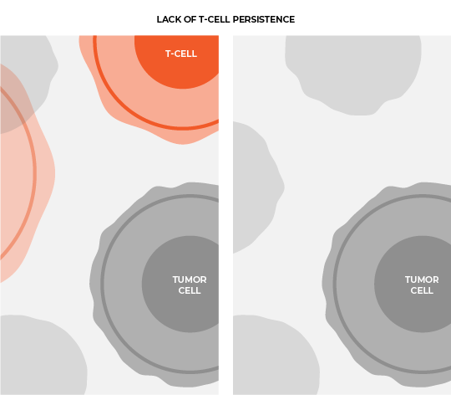
CRG-023, A Tri-specific CAR T Designed To Improve Patient Outcomes
Antigen escape
Loss of co-stimulation
Lack of T-cell persistence
Multi-specificity
New Co-Stim Technology
Design & Engineering
Expression of three specific chimeric antigen receptors
CAR-Engineered,
CD2 technology
New human binders, optimized CAR design,
multi-cistronic engineering

Slide 3
CRG-023 Expresses Three Independent CARs, Targeting CD19, CD20, CD22
Functional optimization through engineering and screening
Single Lentiviral Vector
MND promoter
CD22 CAR
P2A
CD19 CAR
T2A
CD20 CAR
Novel, human scFvs from antibody discovery campaigns for CD19 and CD20
CAR22
(m971-scFV)
CAR19
(19c493 scFV)
CAR20
(20c27 scFV)
Binders
Top CD19 and CD20 binders as mono-specific CARs
CD8 hinge
CD8 TM
CD28 hinge
CD28 TM
CD28 hinge
CD28 TM
CARs
Top CARs in bi- and tri- format to determine vector compatibility
Engineer
4-1BB
CD28
CD2
CD3ζ
CD3ζ
CD3ζ
CRG-023
Three different co-stimulatory domains​
Novel CD2 co-stim

Slide 4
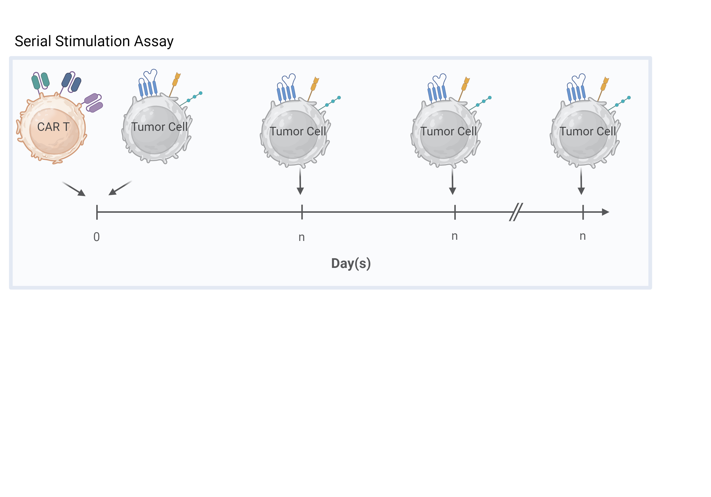
CAR-023 Sustained Anti-tumor Activity And Central Memory Phenotype In Long Term, Serial Stimulation Assays
Serial Stimulation Assay
0
n
n
n
Day(s)
CAR-023 CAR T cells are research produced and representative of CRG-023 product candidate

Slide 5
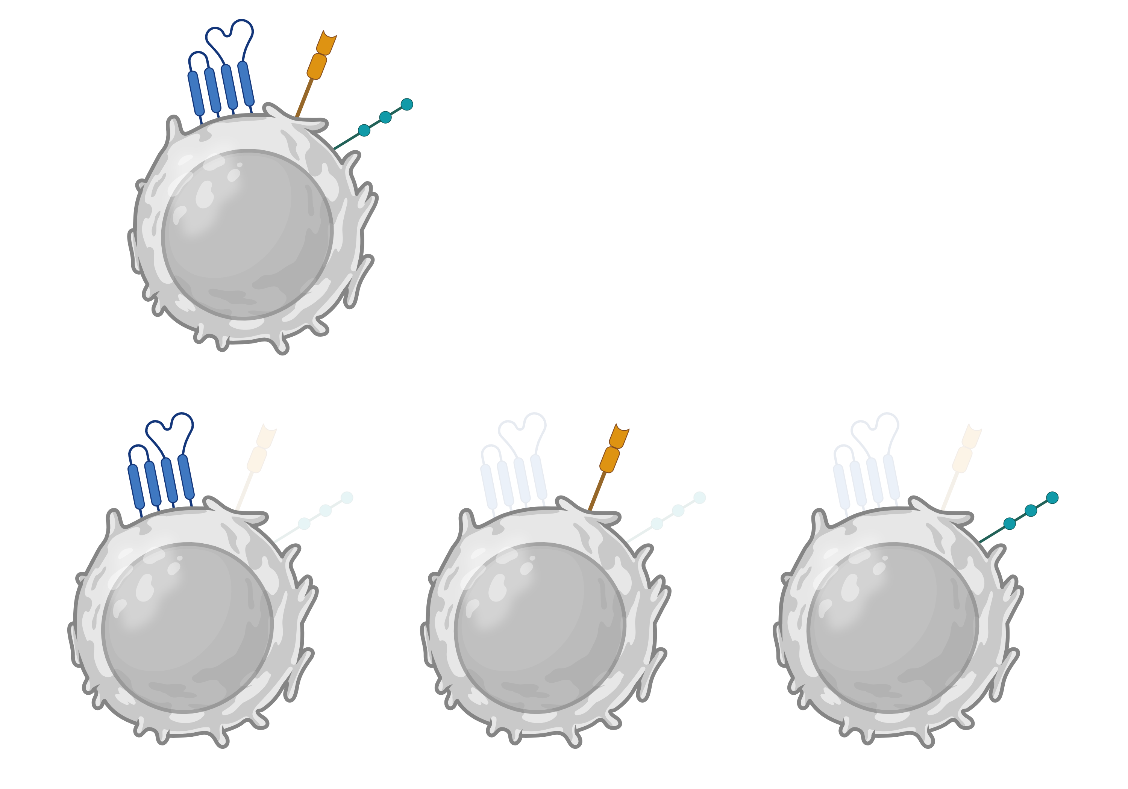
CAR-023 Sustained Anti-tumor Function When Activated By Single Antigen
Serial Stim w/ Raji
(CD19⁻, CD20⁻, CD22⁺)
Serial Stim w/ Raji
(CD19⁺, CD20⁻, CD22⁻)
Serial Stim w/ Raji
(CD19⁻, CD20⁺, CD22⁻)
n=3, mean±SEM

Slide 6
CAR-023 had Sustained Tumor Control Relative to Benchmarks
CAR-023
FMC63 BBz
FMC63 28z
Tandem
BiCAR
BiCAR
Serial Stim w/ Raji Day 25 Analysis
m971
19c493
20c27
FMC63
FMC63
Leu16
CD20 CAR
FMC63
FMC63
4-1BB
CD28
CD2
4-1BB
CD28
4-1BB
4-1BB
CD28
CD3ζ
CD3ζ
CD3ζ
CD3ζ
CD3ζ
CD3ζ
CD3ζ
CD3ζ
TriCAR nanobodies
TriCAR
OX40
TriCAR
CD27/ICOS
CD19 CAR
CD22
CAR
CD22
CAR
CD20 CAR
Leu16
Leu16
CD22 CAR
FMC63
FMC63
4-1BB
OX40
CD27
ICOS
CD3ζ
CD3ζ
CD3ζ
CD3ζ
CD3ζ
FMC63 – CD19 scFv
Leu16 – CD20 scFv
n=2, mean±SEM

Slide 7
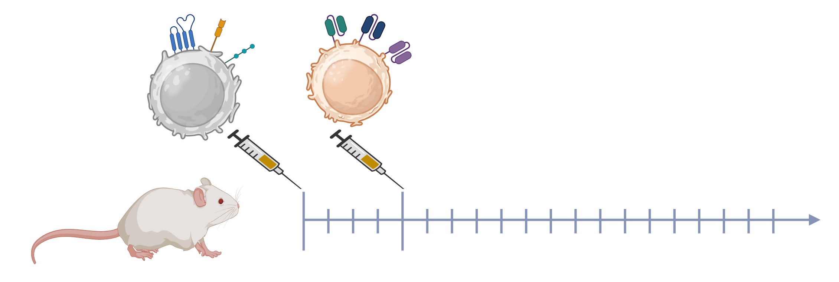
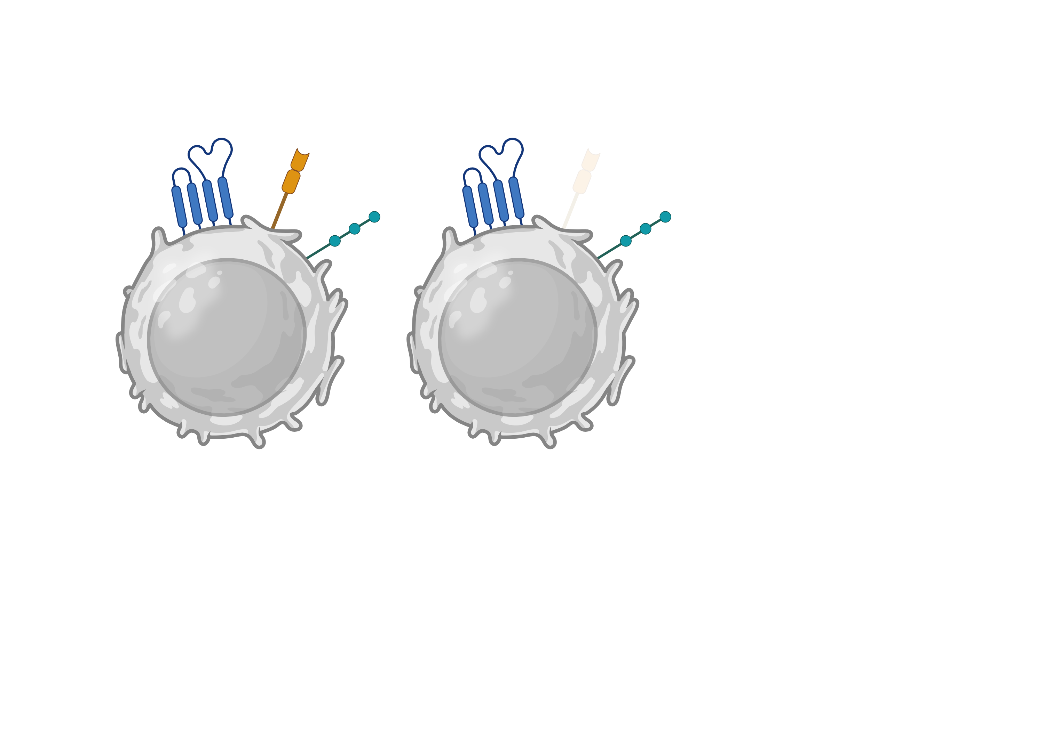
CRG-023 Demonstrated Impressive In Vivo Efficacy At Low CAR T Doses And In Antigen Escape Models
CAR-023
FMC63 BBz
FMC63 28z
m971
19c493
20c27
FMC63
FMC63
90%
WT
10%
CD19ko
Tumor growth monitored by imaging
4-1BB
CD28
CD2
4-1BB
CD28
Raji cells- IV
CAR T cells- IV
CD3ζ
CD3ζ
CD3ζ
CD3ζ
CD3ζ
n=10mice/group; 1 representative of 3 donors
n=5mice/group

Slide 8
CRG-023 Results Showed Enhanced Durable Activity Against Pre-clinical Lymphoma Models
CD19
New binders for CD19, CD20 and a CD2 co-stimulatory domain were design features added to enhance CAR-mediated activity
CRG-023 is a tri-specific, tri-cistronic CAR T
cell product candidate engineered to target CD19, CD20, and CD22
CRG-
023
CD20
CD22
Durable anti-lymphoma activity was observed in vivo, even at the lowest dose levels assessed and in antigen loss models
CAR-023 had
durable anti-tumor activity in vitro when tumor cells expressed three, two or even one antigen
CAR-023 outperformed benchmark controls
Mechanistic insights inform preclinical data to support the planned IND

