Slide 1
CRG-023, A Novel Tri-specific CAR T Product Candidate Engineered To Prevent Antigen Escape And Sustain Durable Anti-tumor Functionality Against B-cell Malignancies
I. Sagiv-Barfi, E. Liao, M. Mannon, B. Quach, L. Wang, S. Koo-McCoy, M. Yi, J. Byers, N. Nguyen, T. Bentley, S. Yung, Y. Huang, M. Bethune, M. Siegel and M. Ports
Acknowledgement of S. Zompì
ASH abstract
Notes:
Thank you for your interest in CRG-023, a novel tri-specific CAR T cell product candidate designed with the goal to provide more patients with B-cell malignancies with durable responses. My name is Idit Sagiv-Barfi, and I am the research lead at CARGO therapeutics for the studies presented here.

Slide 2
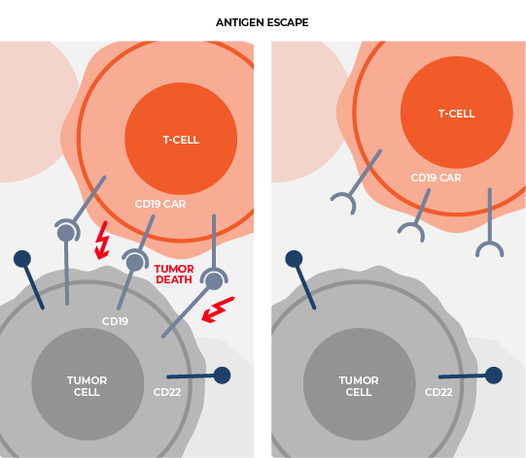
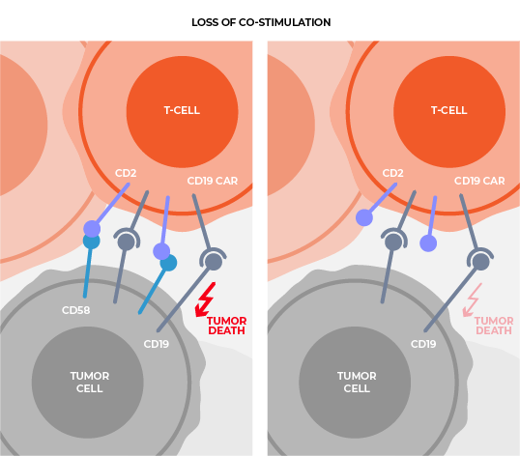
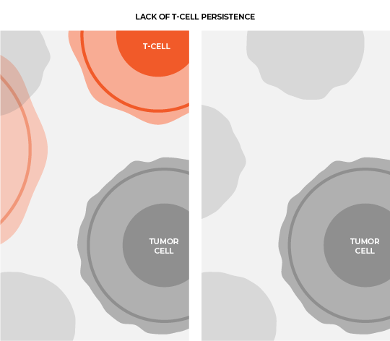
CRG-023, A Tri-specific CAR T Designed To Improve Patient Outcomes
Antigen escape
Loss of co-stimulation
Lack of T-cell persistence
Multi-specificity
New Co-Stim Technology
Design & Engineering
Expression of three specific chimeric antigen receptors
CAR-Engineered,
CD2 technology
New human binders, optimized CAR design, multi-cistronic engineering
Notes:
Knowledge of factors that limit response to cell therapies is increasing. For CRG-023, the approach at CARGO therapeutics was to apply this knowledge through engineering and design to prevent antigen escape, overcome loss of co-stimulation and limit onset of T cell exhaustion

Slide 3
CRG-023 Expresses Three Independent CARs, Targeting CD19, CD20, CD22
Functional optimization through engineering and screening
Single Lentiviral Vector
MND promoter
CD22 CAR
P2A
CD19 CAR
T2A
CD20 CAR
Novel, human scFvs from antibody discovery campaigns for CD19 and CD20
CAR22 (m971-scFV)
CAR19 (19c493 scFV)
CAR20 (20c27 scFV)
Binders
Top CD19 and CD20 binders as mono-specific CARs
CD8 hinge
CD8 TM
CD28 hinge
CD28 TM
CD28 hinge
CD28 TM
CARs
Top CARs in bi- and tri- format to determine vector compatibility
Engineer
4-1BB
CD28
CD2
CD3ζ
CD3ζ
CD3ζ
CRG-023
Three different co-stimulatory domains​
Novel CD2 co-stim
Notes:
CRG-023 is a CAR T product candidate that expresses three distinct CARs, each of which target a different B cell antigen. CD19, CD20 and CD22. Since all components of a chimeric antigen receptor are important to unlock therapeutic potential our team optimized each element, . We started with a new binder (scFv) campaign for CD19 and CD20 where we selected binders in CAR format based on optimal activity. Top performing CARs were then screened in bi and tri-CAR specificities to find a vector configuration that enabled effective CAR expression and anti-tumor activity. In the end our team screened several thousand constructs to identify our lead candidate for CRG-023 expressed via a single lentiviral vector. Each of the three CARs has a distinct co-stimulatory domain. The CD20 CAR design incorporates a CD2 costimulatory domain and was informed by observations that CD58 expression loss is associated with poor outcomes to CD19 CAR T-cell therapy.

Slide 4
CAR-023 Sustained Anti-tumor Activity And Central Memory Phenotype In Long Term, Serial Stimulation Assays
Serial Stim w/ Raji (CD19+, CD20+, CD22+)
Serial Stimulation Assay
Control (NTD)
CD20 CAR
0
n
n
n
Tumor cells / well
Day(s)
CD22 CAR
CAR-023
CD22 CAR
CD19 CAR
CD4
CD8
CD4
CD8
CAR-023
n=3, mean±SEM
Days
Tcm based on CD62L and 45RO n=2, mean±SEM
CAR-023 CAR T cells are research produced and representative of CRG-023 product candidate
Notes:
Serial stimulation assays allow our team to assess the durable performance of CAR T cells when repeatedly challenged with antigen expressing tumor cells. CAR-023 (in orange -is research produced and is representative of CRG-023 product candidate). In the top right is a representative data demonstrating impressive and sustained anti-tumor activity for at least 30 days relative to mono-specific CAR T controls. On the bottom right, this durable activity was further validated by the observation that both CD4 and CD8 CAR-023 T cells maintained expression of surface markers associated with a less differentiated, more central memory like phenotype.

Slide 5
CAR-023 Sustained Anti-tumor Function When Activated By Single Antigen
Serial Stim w/ Raji (CD19⁻, CD20⁻, CD22⁺)
Serial Stim w/ Raji (CD19⁺, CD20⁻, CD22⁻)
Serial Stim w/ Raji (CD19⁻, CD20⁺, CD22⁻)
Tumor cells / well
Tumor cells / well
Tumor cells / well
Days
Days
Days
Control (NTD)
Control (NTD)
Control (NTD)
CD22 CAR
CD19 CAR
CD20 CAR
CAR-023
CAR-023
CAR-023
n=3, mean±SEM
Notes:
Here, we assessed whether CAR-023 could sustain anti-tumor activity when the CAR T cells were stimulated only with a single antigen. Importantly, durable anti-tumor activity was observed in all three single antigen conditions, demonstrating the CAR-023 is not dependent on the activation of any single CAR to sustain its anti-tumor activity

Slide 6
CAR-023 had Sustained Tumor Control Relative to Benchmarks
CAR-023
FMC63 BBz
FMC63 28z
Tandem
BiCAR
BiCAR
Serial Stim w/ Raji Day 25 Analysis
m971
19c493
20c27
FMC63
FMC63
Leu16
CD20 CAR
FMC63
FMC63
4-1BB
CD28
CD2
4-1BB
CD28
4-1BB
4-1BB
CD28
CD3ζ
CD3ζ
CD3ζ
CD3ζ
CD3ζ
CD3ζ
CD3ζ
CD3ζ
TriCAR nanobodies
TriCAR
OX40
TriCAR
CD27/ICOS
CD19 CAR
CD22
CAR
CD22
CAR
CD20 CAR
Leu16
Leu16
CD22 CAR
FMC63
FMC63
4-1BB
OX40
CD27
ICOS
CD3ζ
CD3ζ
CD3ζ
CD3ζ
CD3ζ
FMC63 – CD19 scFv
Leu16 – CD20 scFv
n=2, mean±SEM
Notes:
Next we assessed CAR023 activity relative to mono, bi and tri-CAR benchamerks. The graph on the right, represents a snapshot of the serial stimulation assay at a single timepoint. As demonstrated here CAR023 here in orange, exhibited sustained tumor control at day 25 as compared to benchmarks.

Slide 7
CRG-023 Demonstrated Impressive In Vivo Efficacy At Low CAR T Doses And In Antigen Escape Models
CAR-023
FMC63 BBz
FMC63 28z
m971
19c493
20c27
FMC63
FMC63
90%
WT
10%
CD19ko
Tumor growth monitored by imaging
4-1BB
CD28
CD2
4-1BB
CD28
Raji cells- IV
CAR T cells- IV
CD3ζ
CD3ζ
CD3ζ
CD3ζ
CD3ζ
10¹¹
Control (NTD)
10¹²
Control (NTD)
10¹⁰
CRG-023 3.0E+06
10¹¹
CAR-023
CRG-023 1.0E+06
FMC63-BBz
10⁹
10¹⁰
FMC63-28z
10⁸
CRG-023 3.0E+05
10⁹
10⁷
CRG-023 1.0E+05
10⁸
10⁶
10⁷
10⁵
10⁶
n=10mice/group; 1 representative of 3 donors
n=5mice/group
Notes:
CRG-023 Was highly active in our in vivo models. Tumor clearance was observed at the lowest dose levels tested. At 100,000 CAR T cells/mouse we noted that tumor burden increased 100 fold prior to a CAR T cell response which makes for an even more impressive tumor control at such low CAR T cell dose.
The CD19 antigen loss model on the right demonstrated how effective CAR-023 was at controlling tumor when antigen is lost. This is one example of many experiments of antigen loss models we have tested where the results show durable tumor control, even when the expression for one or two antigens is lost.

Slide 8
CRG-023 Results Showed Enhanced Durable Activity Against Pre-clinical Lymphoma Models
CD19
New binders for CD19, CD20 and a CD2 co-stimulatory domain were design features added to enhance CAR-mediated activity
CRG-023 is a tri-specific, tri-cistronic CAR T cell product candidate engineered to target CD19, CD20, and CD22
CRG- 023
CD20
CD22
Durable anti-lymphoma activity was observed in vivo, even at the lowest dose levels assessed and in antigen loss models
CAR-023 had durable anti-tumor activity in vitro when tumor cells expressed three, two or even one antigen
CAR-023 outperformed benchmark controls
Mechanistic insights inform preclinical data to support the planned IND
Notes:
To conclude, our data demonstrates enhanced durable activity in pre clinical lymphoma models of CRG-023-tri specific CAR T product candidate
I would like to thank the entire research team and technical operations at CARGO for their contributions and thank you for your attention.

